Slide 1
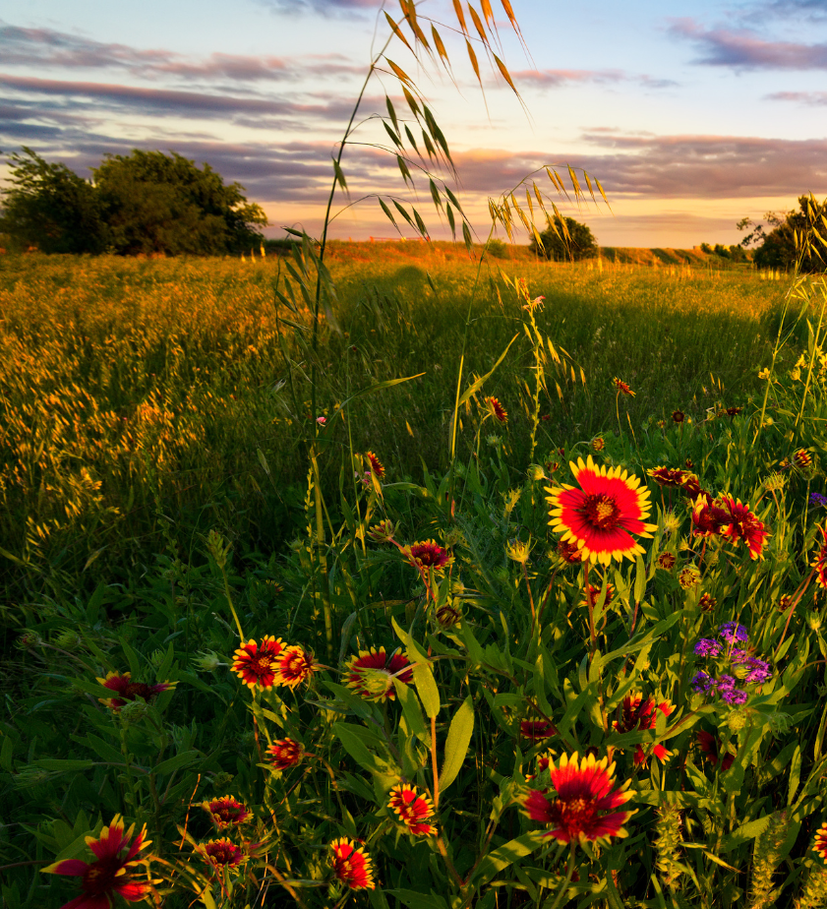
Taking Care of Texas While You’re Scouting
Notes:
Today I'm going to talk to you about how to Take Care of Texas while scouting. We’ll go over some tips on how to be a good conservationist and take care of the environment while we’re scouting.

Slide 2
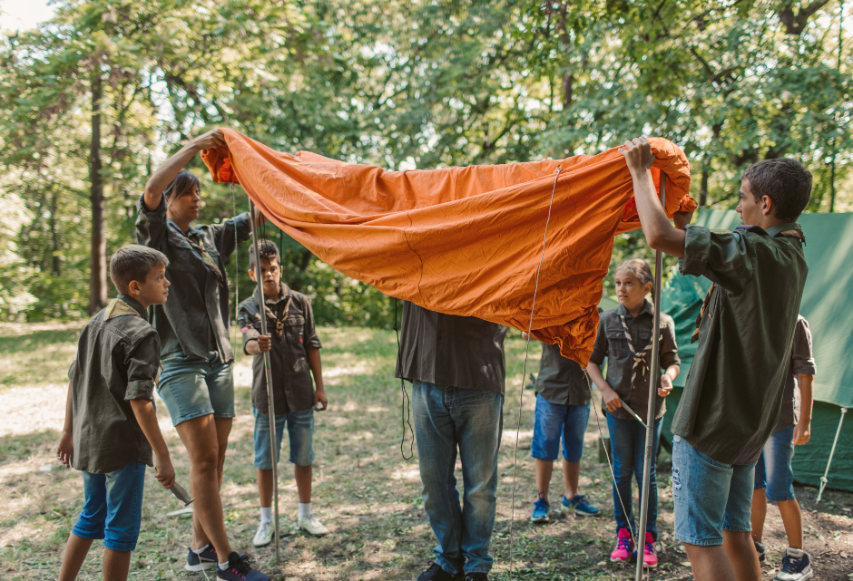
Camping
“Leave no trace”
Don’t transport firewood farther than 50 miles.
Wash dishes and use soap 200 feet away from streams and lakes.
Notes:
Leave no trace: You're all familiar with this concept. Make sure you take all trash and recyclable materials home with you.
Don’t transport firewood: Transporting firewood over long distances increases the risk of introducing invasive species like the Emerald Ash Borer or fire ants to a new location. Use firewood that you find nearby or purchase firewood within 50 miles from where you camp.
Wash away from streams and lakes: Detergents, toothpaste and soap harm fish and other aquatic life. Scatter gray water 200 ft away from streams and lakes so it filters through the soil.

Slide 3
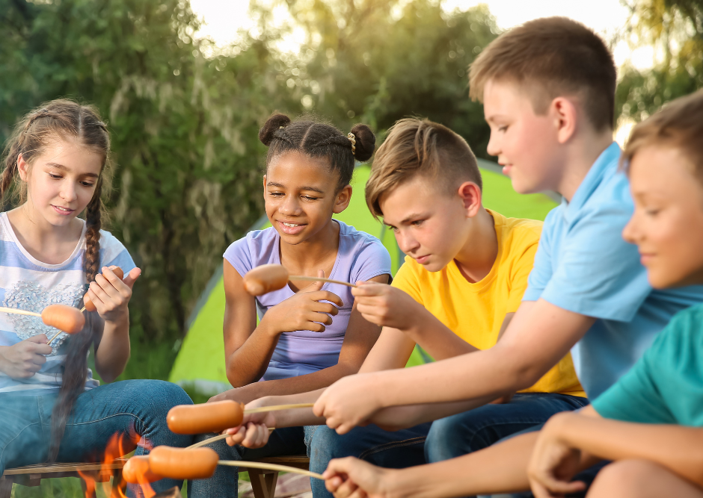
Cooking
Cookouts
Use your mess kits.
Dispose of food scraps properly.
Never leave your cookfire (or campfire) unattended.
Notes:
Mess kits: Instead of using disposable items like paper plates and plastic utensils, use your mess kits. You’ll create much less waste and spend less money.
Food scraps: You don’t want to attract wildlife into your camping area. Bag them up for composting later or dispose of it an authorized trash bin in the campsite.
Unattended fire: An unattended fire can devastate natural areas, displace wildlife, not to mention put human lives at risk. Always have a hose, bucket of water, or shovel and dirt or sand nearby to put out the fire. Make sure to put it completely out before leaving the site.

Slide 4
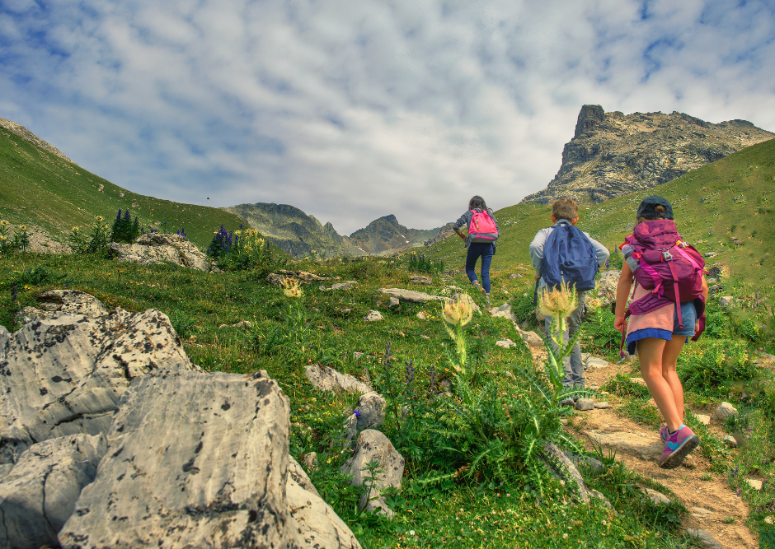
Hiking
Fill a reusable bottle and take it with you.
Don’t pick the wildflowers.
Never remove rocks, plants, or soil from nature.
Notes:
Water bottle: Water is essential to you when going on a long or even a short hike. While it might be tempting to grab a convenient plastic water bottle, instead fill a reusable water bottle to take with you. You’ll create less plastic waste and reduce your carbon footprint.
Don’t pick the wildflowers: They need to sow their seeds to create new plants. The more native plants in the wild, the better!
Never remove rocks, plants or soil from nature. If you see someone not adhering to these practices, say something.

Slide 5
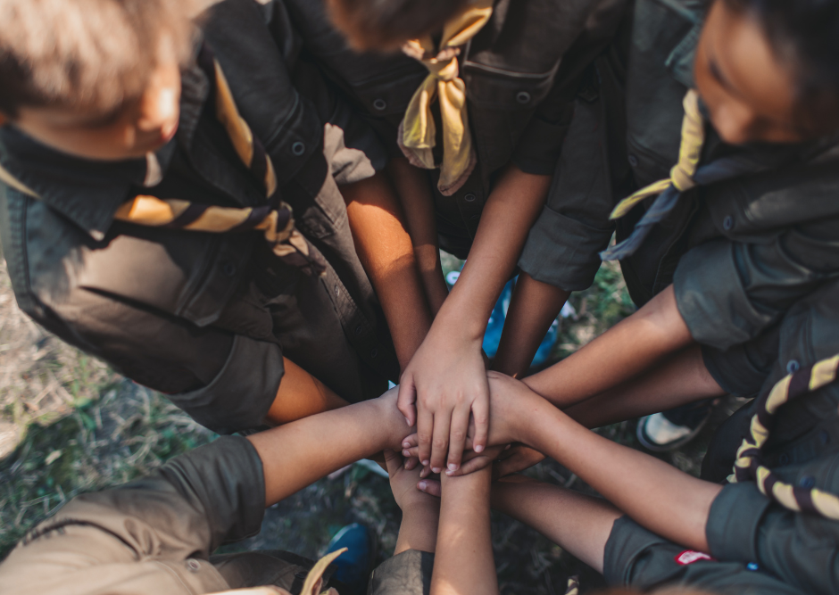
Meetings
Carpool to meetings with your fellow scouts.
Use reusable plates and utensils if you're eating snacks.
Turn off lights after your meeting is over.
Notes:
Carpooling together keeps other vehicles off the road and burns less fuel. This reduces the emissions those cars would have released into the air, keeping our air cleaner and water cleaner.
If you’re going to be eating at your meetings, refrain from using disposable plates and plasticware. Use traditional flatware and utensils. This saves landfill space, not to mention that you won’t have to keep buying more disposable plates. It can get expensive over time.
Remember to turn off all the lights once your meeting is over. Turning off just one bulb that would burn for 8 hours a day will save about $20 a year.

Slide 6
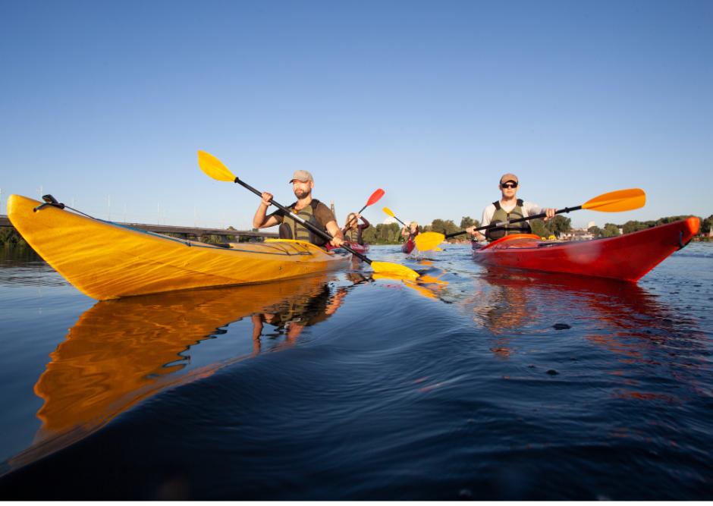
Swimming, Fishing, and Boating
Clean, drain, and dry your boat to prevent spreading invasive species.
Don’t dump anything into the water that you shouldn’t.
Obey all fishing regulations.
Notes:
Spreading invasive species is a problem in Texas: Zebra mussels, Giant Salvinia, Water Hyacinth
No dumping: This includes fuel, lubricant, non-native shrimp bait, etc. We want to keep our watersheds clean. Learn more about keeping our water clean by exploring the “Don’t Mess with Texas Water” program.
Fishing Regulations: Make sure you keep only legal fish and throw back the ones that are too small. Doing so respects the marine ecosystems and allows the reproductive rate of fish to maintain a balance and ensure the survival of all species

Slide 7
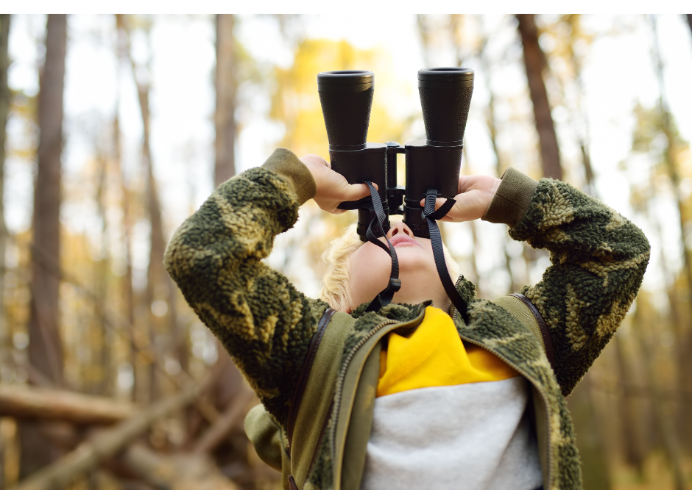
Animal/plant/insect identification or birding:
Be mindful not to take or disturb the various life forms you see.
Dispose of all waste and trash.
Use the app iNaturalist to identify what you find out in nature.
Notes:
- Never attempt to feed wildlife—no matter how docile or friendly the animals might appear. You don’t want to teach wild animals that it’s ok to approach people for food.
- If you brought it with you, make sure you take it out with you. Don’t leave anything around your campsite or on the trail. This can contaminate waterways, watersheds, not to mention leaving the landscape trashed.
- iINaturalist is a very handy app that uses a social network of naturalists, citizen scientists, and biologists to help identify the plants and animals around you. iNaturalist is a social network of naturalists, citizen scientists, and biologists built on the concept of mapping and sharing observations of biodiversity across the globe. The app may be accessed via its website or from its mobile applications.

Slide 8
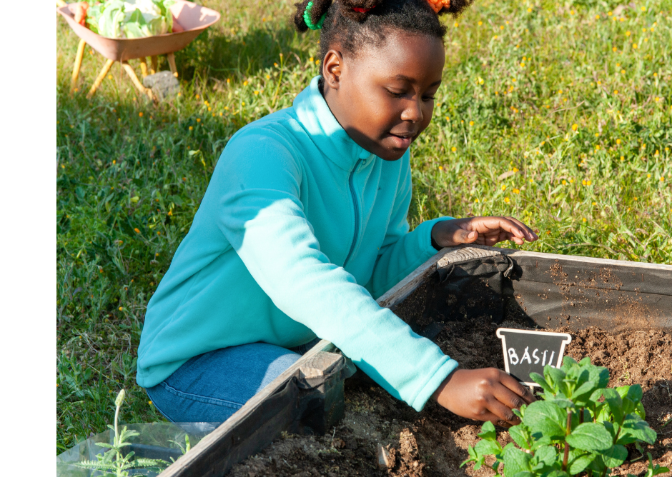
Gardening
Make and use compost.
Use mulch to control erosion and retain soil moisture.
Use only the right amount of fertilizer.
Don’t overwater.
Notes:
Compost – Compost is recycled, decomposed organic material that can feed and protect a lawn and garden. It’s typically made of food scraps, leaves and lawn clippings. A garden with compost will use less water, need less fertilizer, and reduce the waste going into a landfill. You can make compost for your garden by starting a compost pile in your backyard.
Mulch - You can make your own mulch using shredded leaves, sticks and logs from your yard. When placed over soil, it can help to retain moisture. Later, when it breaks down, it can also act as a fertilizer feeding the soil and plants.
Fertilizer - Too much fertilizer can spill out of your lawn and garden and into the watershed when there is a downpour.
Overwatering – Watering too much wastes our most precious resource, erodes your soil, and spills any fertilizer into the watershed.

Slide 9
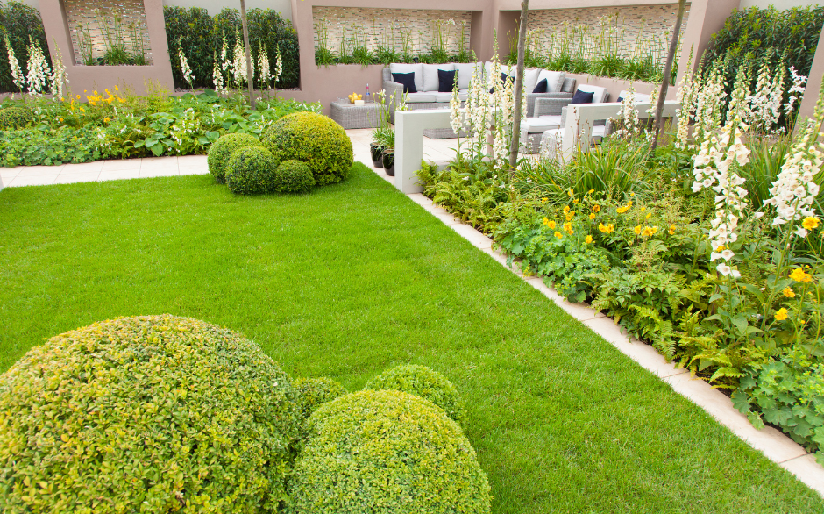
Gardening
Irrigate in the morning or evening.
Construct a rain barrel to harvest rainwater.
Use native and well-adapted plants.
Notes:
Irrigate in the morning or evening. Wind and temperatures are usually the lowest of the day in the early morning. This will greatly reduce the amount of water lost to evaporation in the brutal Texas heat! You can lose around 30% of your water irrigating in the day.
Rain barrel –Save and use the resources that nature gives you. Harvesting rainwater to saves even more water. Your garden will appreciate the extra moisture.
Using native and well-adapted plants is one of the easiest ways to create a beautiful, low-maintenance, and environmentally sound yard. They will require less maintenance and less resources as they are already adapted to the local climate.

Slide 10
Take Care of Texas Scout Program
Girl Scouts & Boy Scouts who are doing their part to preserve and protect the Texas environment can earn the Take Care of Texas patch
Scouts who want to go one step further can earn our pin! By completing an 8-hour service project, this award will prove a scout’s commitment to preserving and protecting our state’s natural resources.
Notes:
There are different requirements for Scouts BSA and Girls Scouts to earn their respective patches and pins. All the details and requirements can be found at the link above. Be sure to check if your scout council participates in our awards program. This information can also be found on the Take Care of Texas website. If they don’t currently participate, encourage them to do so and to contact us via our website.

Slide 11
For more ways to Take Care of Texas, visit TakeCareofTexas.org.
Learn about our Scout patch and pin

