Slide 1
Program Overview
A Take Care of Texas Presentation

Slide 2
Presentation Overview
Program Overview & History
Key Program Features
Important Online Resources
How to Get Involved

Slide 3
What is “Take Care of Texas?”
Program Overview & History
3

Slide 4
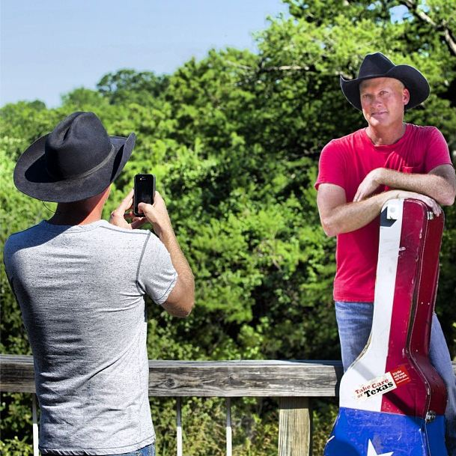
What is “Take Care of Texas?”
Take Care of Texas is a statewide campaign from the Texas Commission on Environmental Quality that encourages all Texans to help keep our air and water clean, conserve water and energy, and reduce waste.
TCEQ originally created this program in the 1990s with a re-launch in May 2007 when “Take Care of Texas” was trademarked to TCEQ. Over the years, TCOT has published information and activities to help Texans of all ages better take care of their state.
TCOT offers many educational and outreach opportunities for Texans online, including conservation calculators, interactive tools, newsletters, and a personal conservation pledge. Offline, TCOT has worked with country stars to create PSAs, offers print publications for residents and educators, and works with “proud partners” to help promote conservation within businesses.

Slide 5
TCOT Program Videos
Simple Ways to Take Care of Texas
Take Care of Texas, It's the Only One We've Got!

Slide 6
Key Program Features
Essential Program Components
6

Slide 7
Educator Resources
We offer high-quality, FREE resources to help make educators’ jobs easier and teach students how they can do their part to Take Care of Texas.
We encourage educators to:
Order our FREE printed materials for your class, school, or event.
Project interactive activities and PDFs on your classroom whiteboard.
Download ready-made lesson plans, many of which are aligned to TEKS.
Use the interactive content to complement your classroom lessons.
Get ideas and resources for making your school eco-friendly or hosting service projects.

Slide 8
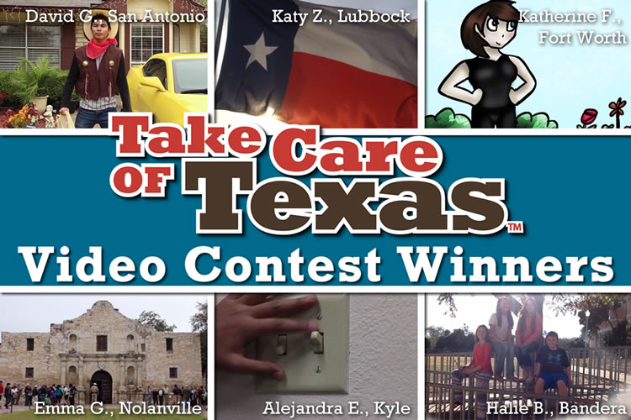
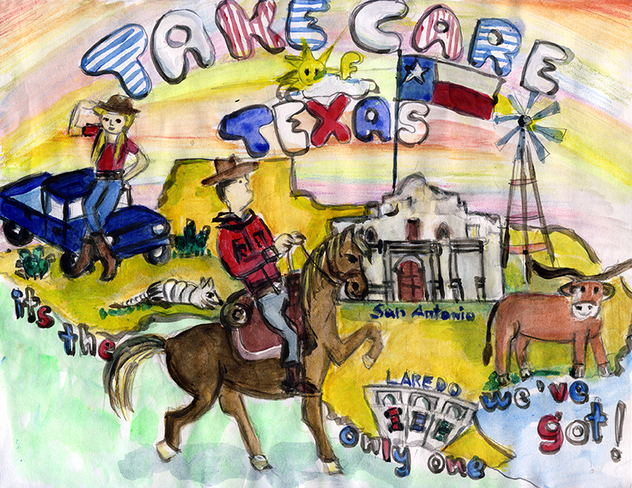
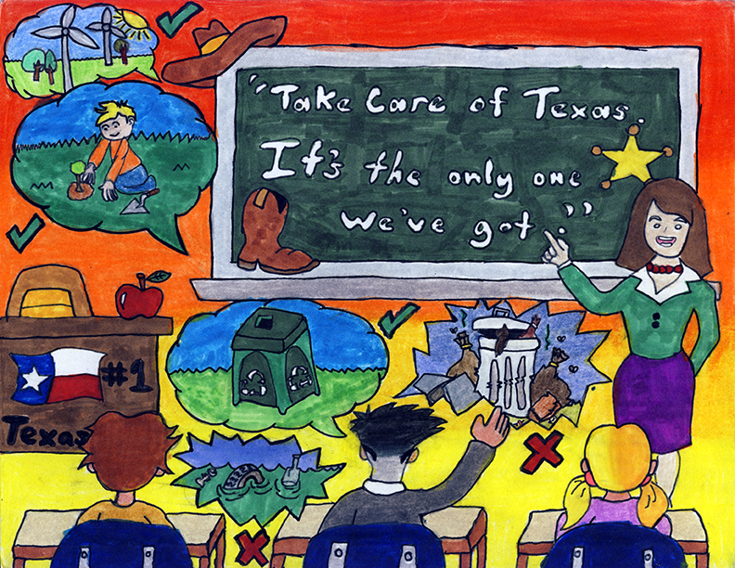
Student Contests
K-5th Art Contest
6-12th Video Contest
The kids’ art contest is for K-5th students to learn about protecting the environment and come up with ways to share this knowledge with others!
Students submit their artwork of how they help keep the air and water clean, conserve water and energy, and reduce waste.
The students that submit the best art can win a tablet or laptop computer. Prizes are made possible through a donation from the Texas Chemical Council.
The video contest is for 6-12th students to learn about protecting the environment and express ways to share this knowledge with others!
Students film a 30-second PSA-style video that shows positive ways to Take Care of Texas.
The students that submit the best videos can win great prizes, awarded by the contest sponsor, Waste Management of Texas, Inc.

Slide 9
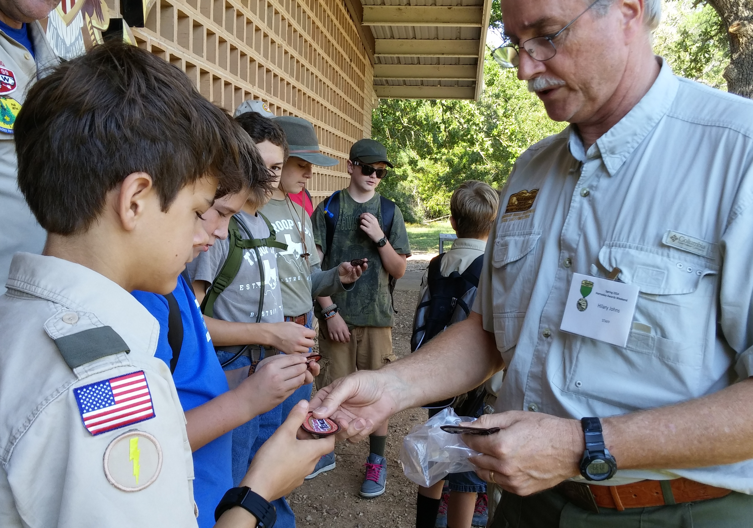
Campaigns & Partnerships
Country Star PSAs
Proud Partners
Scout Organizations
Since 2013, TCOT has partnered with recording artists like Kevin Fowler, Rick Trevino, and Cody Johnson to produce PSAs encouraging Texans to protect our state’s natural resources. These PSAs aired on television and radio stations statewide in both English and Spanish.
TCOT’s Proud Partner Program is an organizational responsibility program that allows nonprofits, corporations, governments, and private entities to take a pledge demonstrating their commitment to protecting the Texas environment.
TCOT recognizes Girl Scouts & Boy Scouts who are doing their part to conserve water and energy, keep our air and water clean, and reduce waste. These patches and awards symbolize a commitment to both learning and educating others on how we can keep our state great.

Slide 10
Important Online Resources
Key Resources Accessible Online
10

Slide 11
Important Online Resources
Take the Pledge
Make a Difference
We encourage Texans to “Take the Pledge” and indicate which ways they will actively help to conserve water and energy, and keep the air clean.
By completing the pledge, Texans can receive a FREE Texas Parks & Wildlife "Texas State Parks: Official Guide" and a FREE Take Care of Texas sticker!
Our “Make a Difference” calculation tool shows Texans their impact on the environment based on the year they were born and average statewide resource usage.

Slide 12
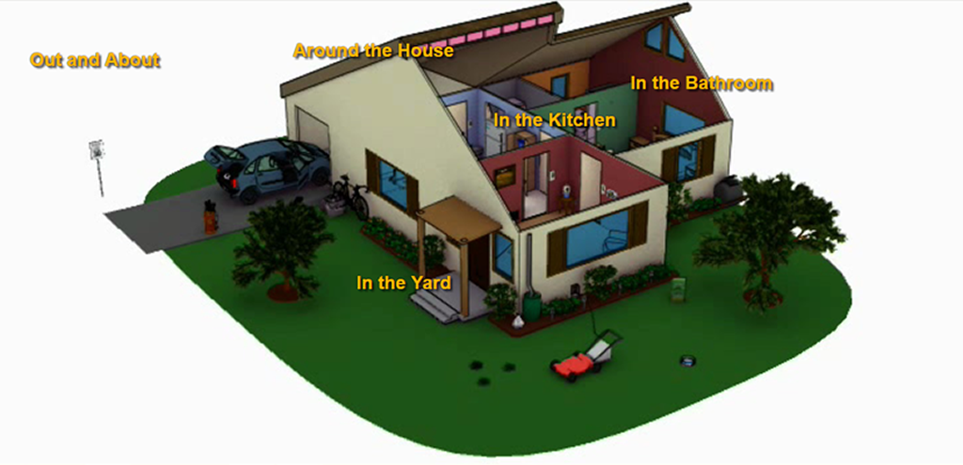
Important Online Resources
Animated House Tool
Savings Calculator
TCOT features an online, interactive house tool highlighting simple steps Texans can take at home to help conserve water and energy, keep the air and water clean, reduce waste, and save a little money in the process.
TCOT’s built-in savings calculator helps Texans estimate how much household water, energy, and money they can save by taking some of the simple steps suggested on the website.

Slide 13
Newsletters
News and information tailored to you
Take Care of Texas News You Can Use is a monthly e-newsletter with helpful information and resources to keep our air and water clean, conserve energy and water, and reduce waste.
The Take Care of Texas Educator Newsletter is a quarterly email with useful information for teaching kids about the environment. It includes free lesson plans and publications, articles about green classrooms and schools, ideas for service projects, and more!
The Proud Partner Newsletter is a quarterly e-newsletter with information to help your business or organization do their part to Take Care of Texas.

Slide 14
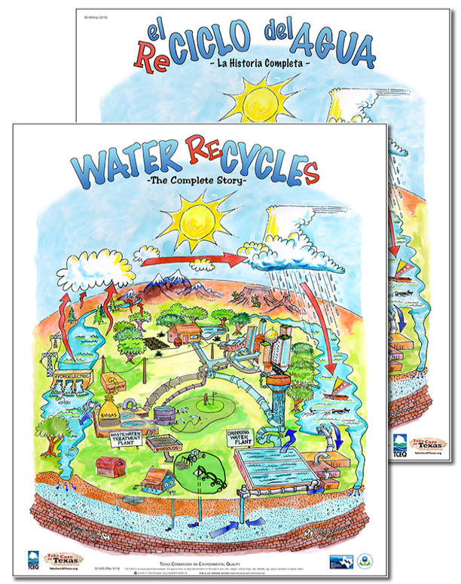
Free Publications & Infographics
TCOT offers a wide collection of FREE publications for Texans of all ages across the state!
These materials include:
Topic-specific infographics and handouts
Brochures for programs and contests
Educational booklets, guides, and posters
Bumper stickers and mirror clings
Materials in both English & Spanish*
And many more!
(Quantities are limited and we cannot ship to PO boxes or outside of Texas. Please allow 7-10 business days for shipping & handling.) *Not all materials have a Spanish translated version

Slide 15
How to Get Involved
Ways to Help Take Care of Texas
15

Slide 16
How to Get Involved
Take the Pledge
Proud Partner Program
TCOT Student Contests
Take the TCOT Pledge!
Make your commitment to Take Care of Texas, and encourage others to make pledges too. Once completed, you can receive a FREE "Texas State Parks Guide" and TCOT sticker!
Contact us for Proud Partner Info!
If your organization is interested in becoming a Proud Partner, contact us to learn more about this program!
We’re always looking to add partners committed to Take Care of Texas.
Promote TCOT Contests!
Spread the word encouraging student participation in the contests for their age bracket, or share with your local schools/teachers to get their students involved!

Slide 17
How to Get Involved
Share Your Story
Order Publications
Newsletter Sign-up
Share your story with TCOT!
Go online and submit your story, with an option to upload a photo, about how you are finding fun, creative ways to Take Care of Texas!
Order FREE publications online!
These materials are great for homeowners, neighbors, kids, teachers, coworkers, family, and friends – really for any Texan wanting to Take Care of Texas!
Sign up for TCOT newsletters!
There are a couple of options depending on your interests. We recommend starting with News You Can Use, or our Educator Newsletter if you are a teacher!

Slide 18
How to Get Involved
Other ways to get involved with Take Care of Texas
Environmental conservation is one of the most important topics we can talk about. So what else can you do to Take Care of Texas?
Advocate – There are many ways to advocate for the Texas environment. We encourage you to discuss simple, easy, and localized conservation efforts and promote Take Care of Texas with your coworkers, friends, family, and other Texans!
Reduce, Reuse, Recycle – Consider your consumption and waste cycle. Can you buy it used or reuse it? Is it recyclable? Do I really need that plastic lid and straw? Is it better to buy this item individually-packaged or in bulk?
Volunteer – Get involved to improve your local environment! Join a cleanup event, plant trees, bring waste bags on walks, etc.
Buy Local – Buying local supports your community and is good for the environment because less resources are used to move goods.
Donate – Contribute financially to local conservation efforts or donate items to be reused versus thrown into the trash.

Slide 19
THANK Y’ALL
Insert Image
For More Info: TakeCareOfTexas.org
Contact us: educate@tceq.texas.gov

